Slide 1
Codebook Cipher
In cryptography, a codebook is a document used for implementing a code.
A codebook contains a lookup table for coding and decoding; each word or phrase has one or more strings which replace it.
To decipher messages written in code, corresponding copies of the codebook must be available at either end.
The distribution and physical security of codebooks presents a special difficulty in the use of codes.

Slide 2
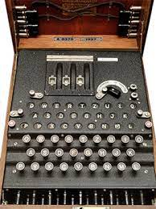
Enigma machine
Each time you press a button on keyboard, different letter lights up in lampboard.
Encrypted message were sent on radio using morse code.
Three parts of Enigma Machine
Rotors
Keyboard mechanism
Plug board

Slide 3
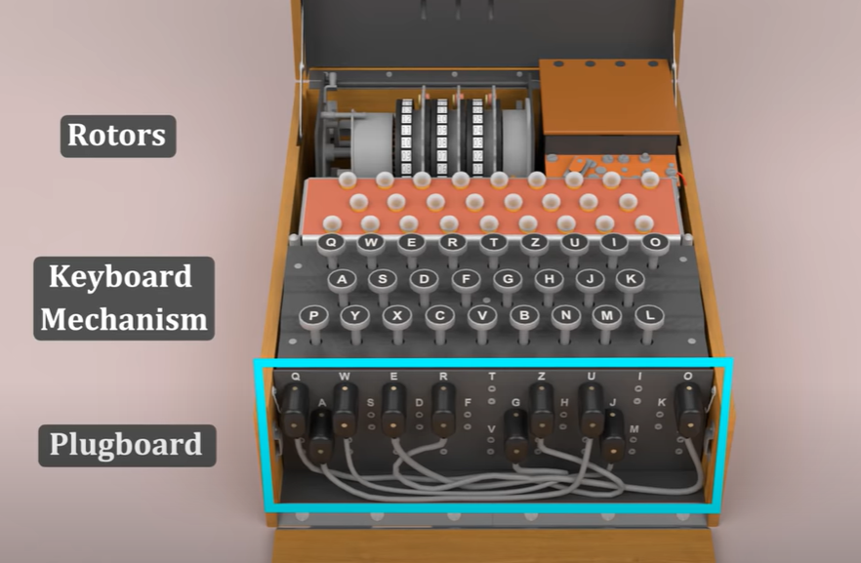
Enigma Machine

Slide 4
Rotors
There were 3 Rotors used in Enigma machine
Each rotor has numbers marked from 01 to 26 for each alphabet.
Each rotor scramble the letter once.
Then reflector reflects back the scrambled text to rotor.
It again passes through rotors and gets scrambled 3 more times.
Then it reaches input wheel where it gets scrambled 1 more time.
All three rotor rotates, so scramble is not fixed. Its very difficult to predict the ciphertext.

Slide 5
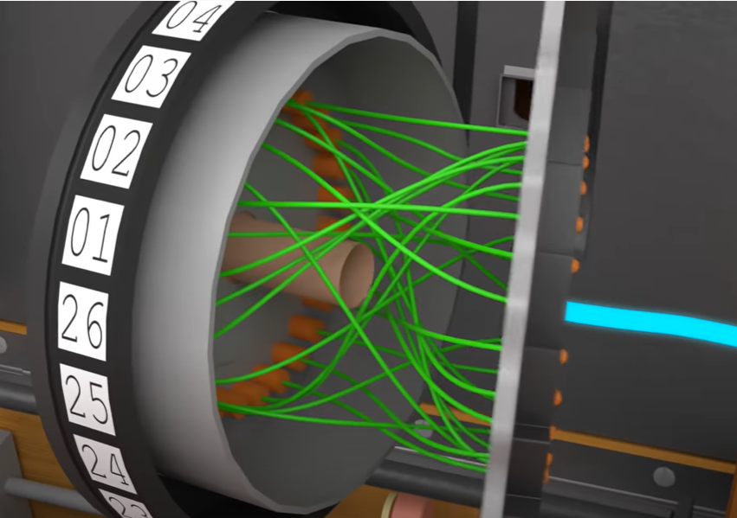
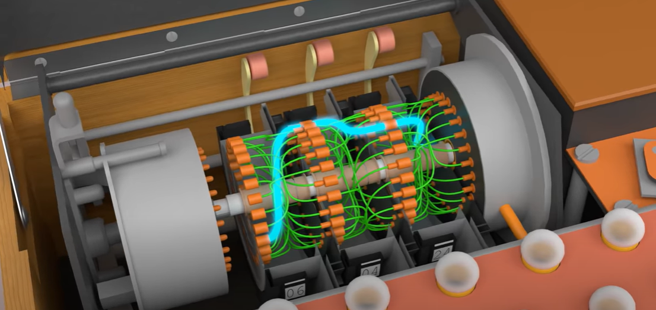
Rotor

Slide 6
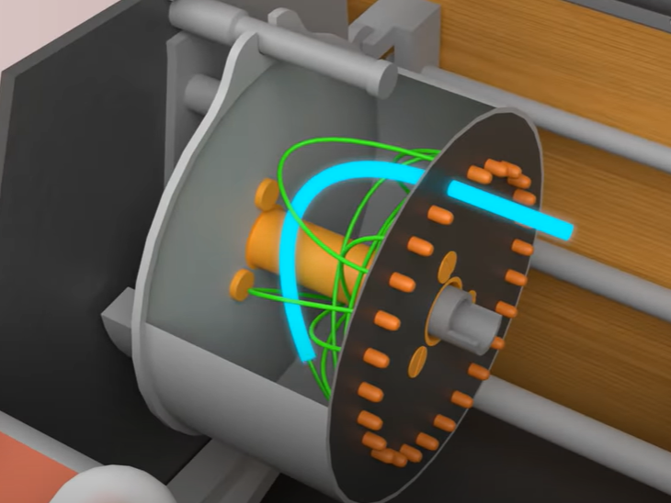
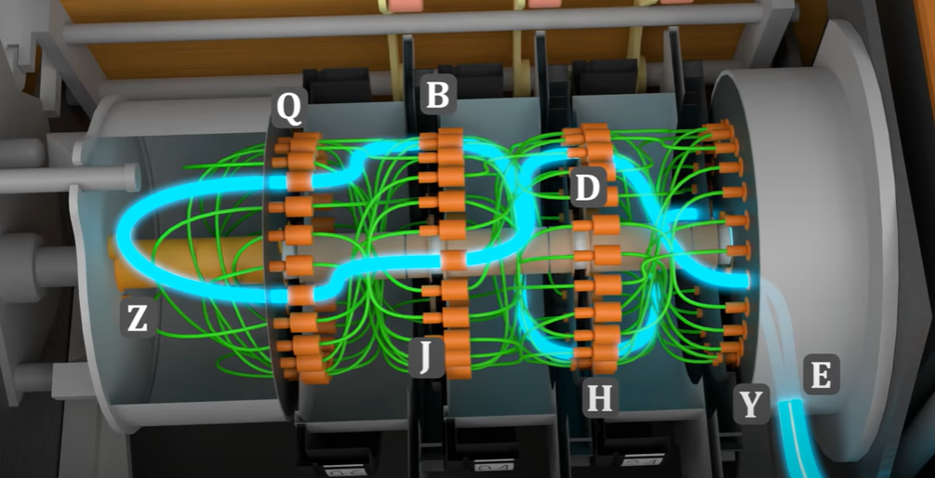
Reflector

Slide 7
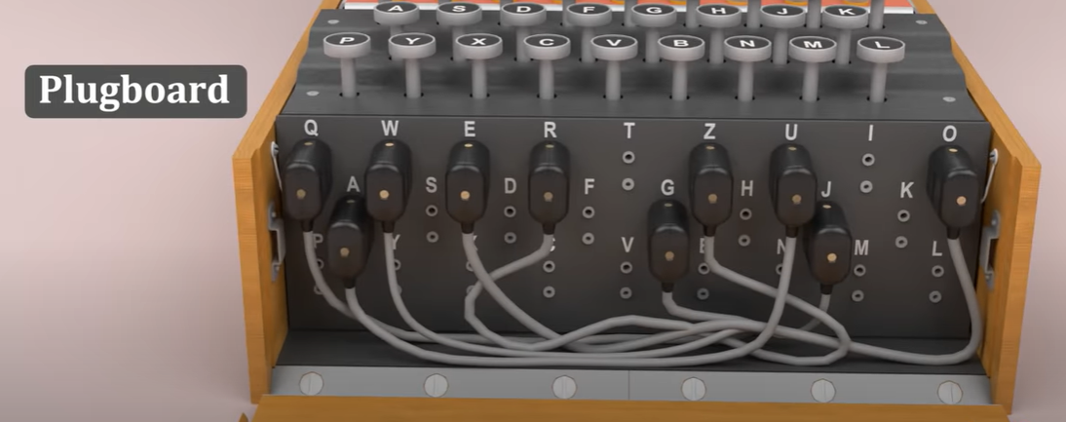
Plugboard
Another way of switching two alphabets.
Upto 10 cables were used.
Letters go to plugboard twice, before rotor and after rotor.
In total, letters can scramble from 7-9 times.

Slide 8
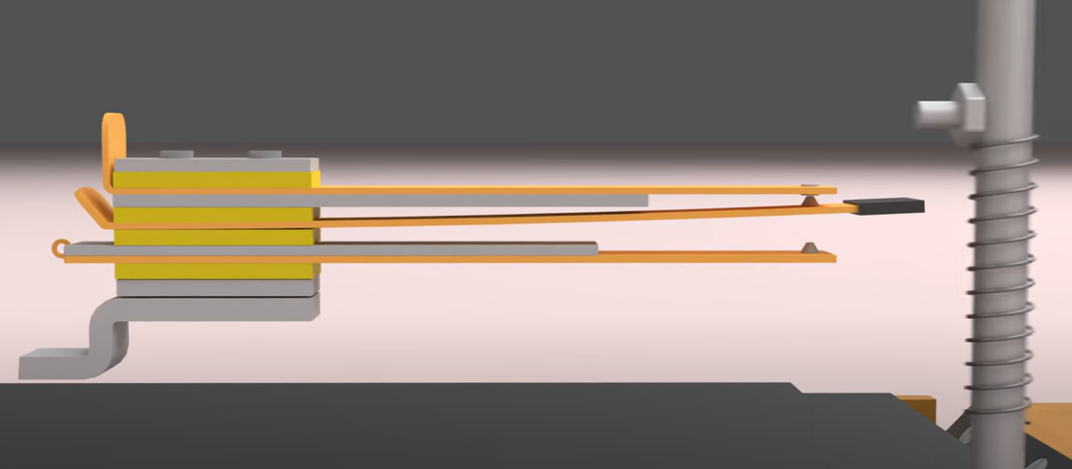
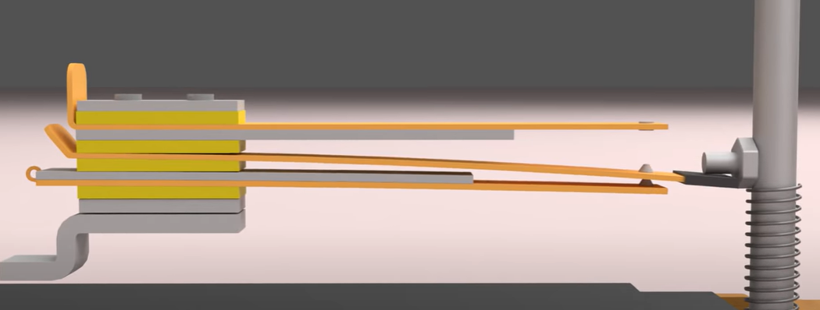
Keyboard Mechanism
When key is not pressed
When key is pressed

Slide 9
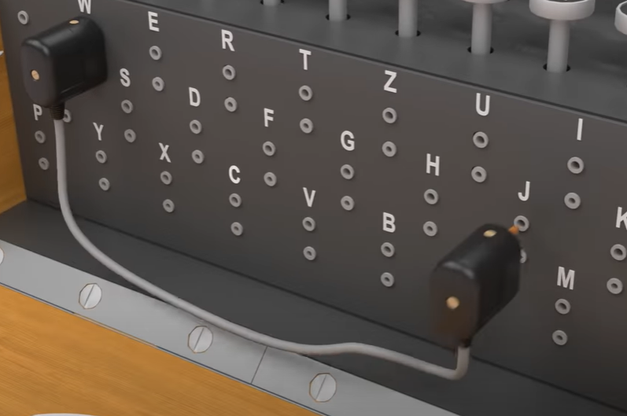
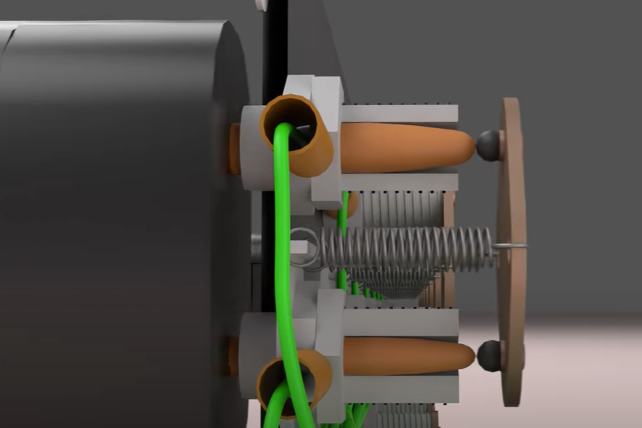
Plugboard

Slide 10
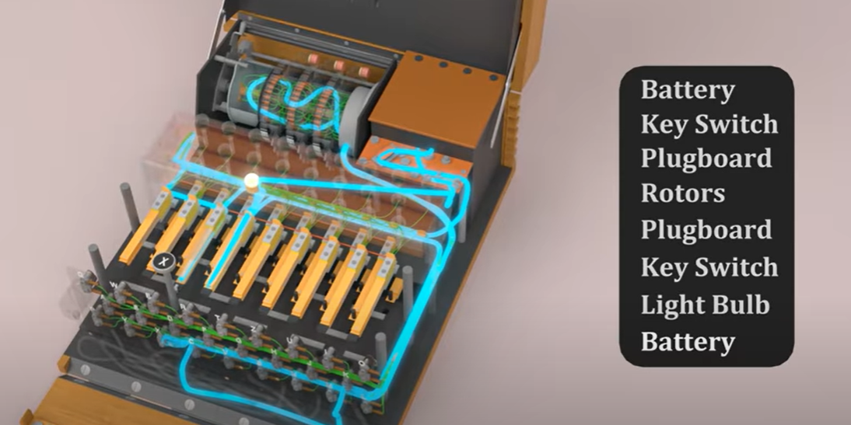
Full Circuit

Slide 11
When a key is pressed, atleast 1 rotor changes.
Initial Settings:
Choose 3 out of 5 different rotors.
Set initial value of rotors.
Connect plugs.

Slide 12
SIGABA
SIGABA is an electric rotor encryption machine.
Similar to Enigma but uses 15 rotors.
SIGABA has no reflector or plugboard.
SIGABA has 3 types of rotos:
5 Control Rotors
5 Index Rotors
5 Cipher rotors
Plaintext goes through cipher rotors and generates ciphertext.

Slide 13
References:
Codebook | Crypto Wiki | Fandom
How did the Enigma Machine work? – YouTube
The U.S. SIGABA Cipher Machine – An Incredible Encryption Device - YouTube

